Slide 1

Cheap Power, Major Consequences:
Breakthrough Auction Prices and
the Future of the Energiewende
[ Strommarkttreffen ]
Toby D. Couture
E3 Analytics
Berlin, Germany
October 20 2017

Slide 2

BRIEF PROFILE:
Toby Couture is Founder and Director of E3 Analytics, an international renewable energy consultancy based in Berlin that focuses on renewable energy markets, policy, and finance. He has worked with over forty countries around the world on the economic, financial, and policy aspects of renewable energy development, including in Asia, the Pacific region, the Middle East, Africa, and the Americas.

Slide 3
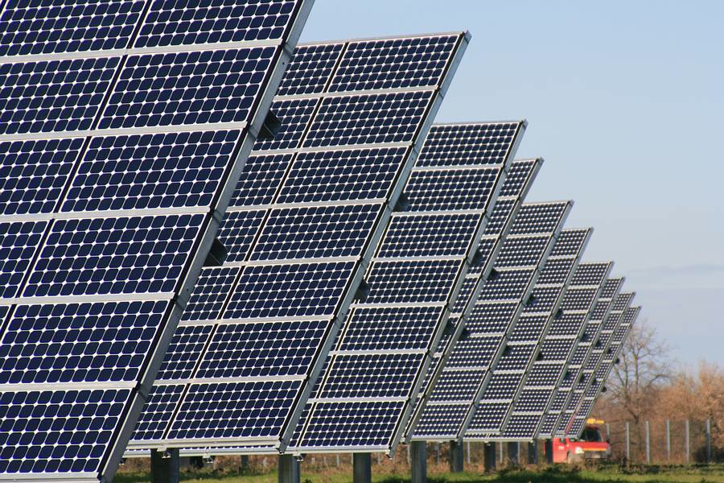
Unsubsidized solar
- March 2016, Mexico:
USD 3.6 c/kWh
- August 2016, Chile:
USD 2.91 c/kWh

Slide 4
Unsubsidized solar
- March 2017, Dubai:
USD 2.42 c/kWh
- October 2017, Saudi Arabia:
USD 1.79 c/kWh (!!)

Slide 5
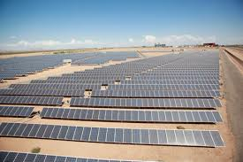
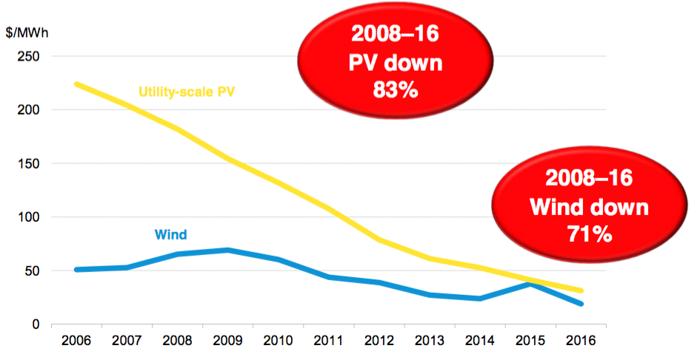
The downward trend is global
Average US renewable energy PPA prices
Source: BNEF 2017

Slide 6
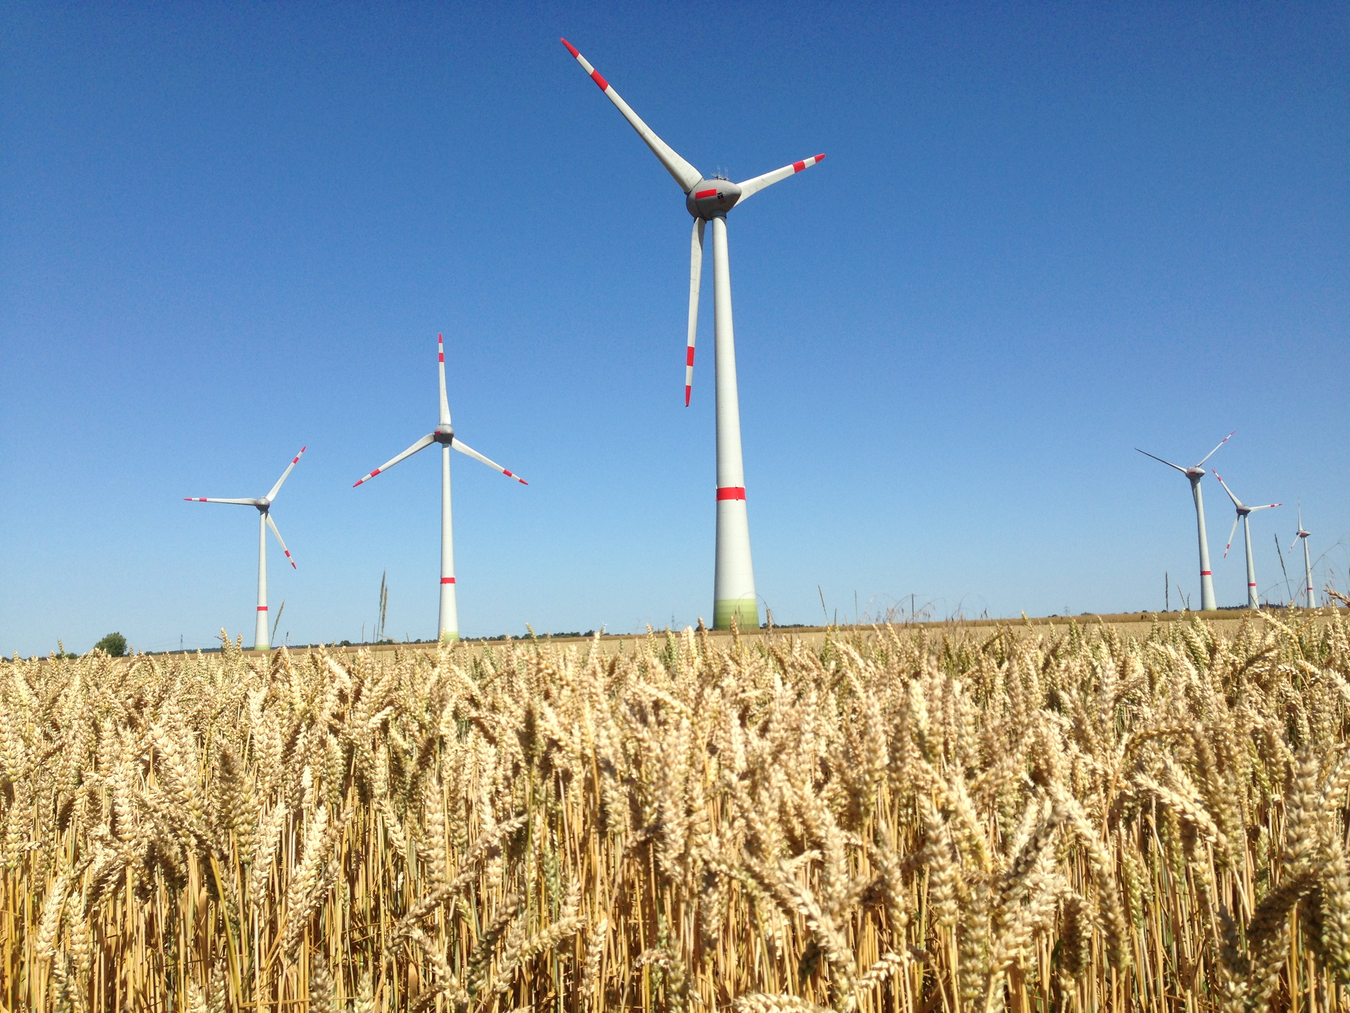
Unsubsidized wind
USD $0.03/kWh wind power auction in Morocco (Jan 2016)
“Market price”-only bid for offshore wind in the North Sea http://gwec.net/the-risks-of-zero-subsidy-offshore-wind/
Etc. Etc.

Slide 7
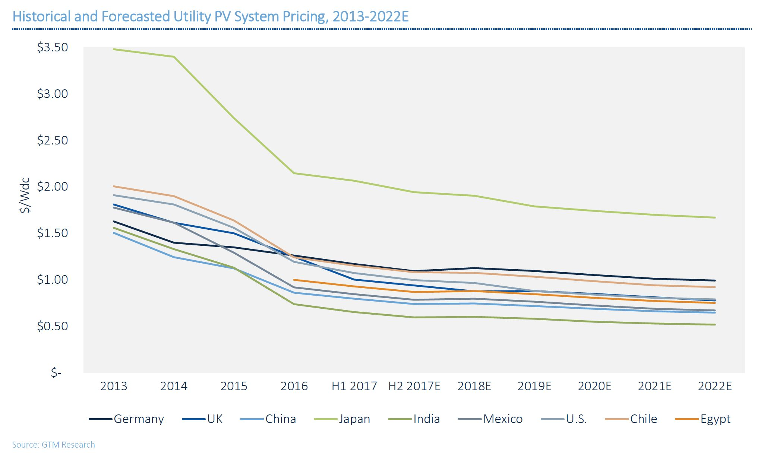
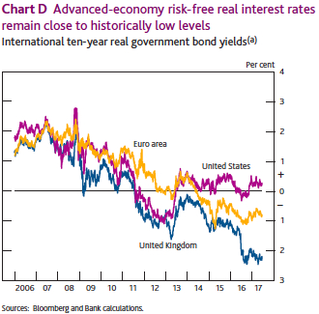
How are such low bids possible?
Decreased technology costs →
Increased (and increasingly global) competition
Economies of scale (1.17GW project in Dubai!)
Land is often pre-packaged/free
Prices often exclude grid connection costs
Low global interest rates →
State-backed financing (e.g. Enel, Masdar)
Gov’t off-taker guarantees

Slide 8

How are such low bids possible? (con’t)
Cheap labor
Inflation adjustment is often not disclosed →
“Loss leader” projects simply to gain a foothold
Long contracts (e.g. 25 yrs)
One-upmanship →
And finally, actual costs might be higher due to to unpublished terms in the contract (off-peak vs. on-peak pricing, etc.) or due to future re-negotiation

Slide 9
Irrational exuberance?
“(Bids) are becoming increasingly divorced from the reality of payments.”
- Jenny Chase, BNEF https://www.bloomberg.com/news/articles/2017-10-03/saudi-arabia-gets-cheapest-ever-bids-for-solar-power-in-auction

Slide 10
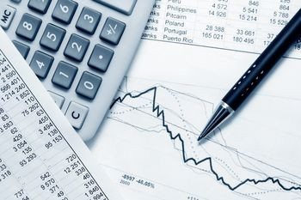
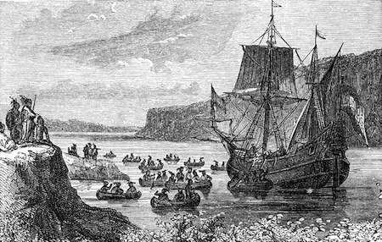
Concluding Remarks
Ultimately, bids have to pencil out: i.e. cash flows have to cover costs
In the months and years ahead, it will become clear whether these low bids can sustain financial scrutiny
We are clearly in uncharted waters

Slide 11
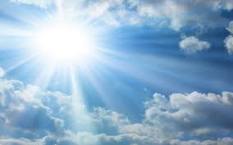
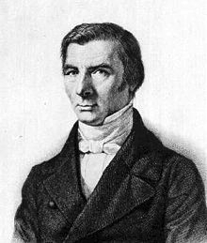
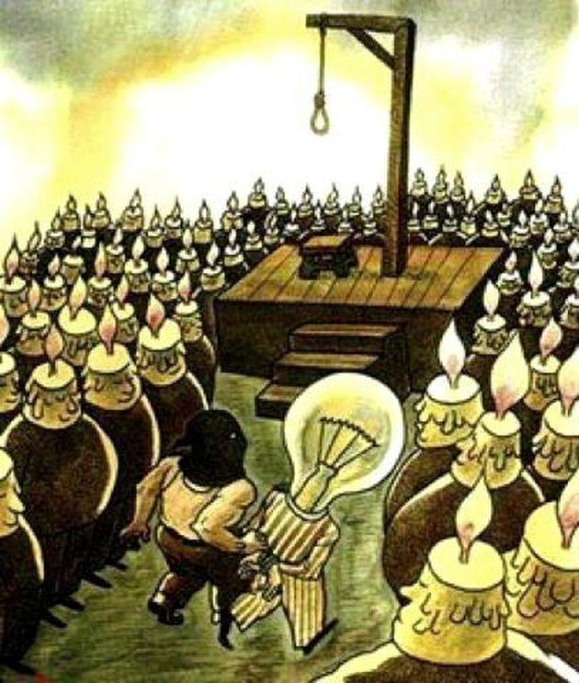
Concluding Remarks
Frederic Bastiat
“We are suffering from the ruinous competition of a rival who apparently works under conditions so far superior to our own for the production of light that he is flooding the domestic market with it at an incredibly low price; for the moment he appears in the morning, our sales cease, all the consumers turn to him, and a branch of our industry whose ramifications are innumerable is all at once reduced to complete stagnation. This rival… is none other than the Sun.”
- http://bastiat.org/en/petition.html

Slide 12
Concluding Remarks
Frederic Bastiat
“We ask you to be so good as to pass a law requiring the closing of all windows, dormers, skylights, inside and outside shutters, curtains, casements, bull's-eyes, deadlights, and blinds — in short, all openings, holes, chinks, and fissures through which the light of the sun is wont to enter houses. Make your choice, but be logical… how inconsistent it would be to admit the light of the Sun, whose price is zero all day long!”
- http://bastiat.org/en/petition.html

Slide 13
Thank you!
Questions?
Toby D. Couture toby@e3analytics.eu www.e3analytics.eu

