Slide 1
H₂-Transportoptionen
Verschiedene Perspektiven im Blick
CONFIDENTIAL AND PROPRIETARY
Any use of this material without specific permission of HYDROGENIOUS LOHC TECHNOLOGIES is strictly prohibited
15.12.23 | Markus Albuscheit | Strommarkttreffen

Slide 2
Problem definition
Hydrogen Economy: Chicken-Egg-Problem
Question: Which basket to transport eggs from/to the chicken?

Slide 3
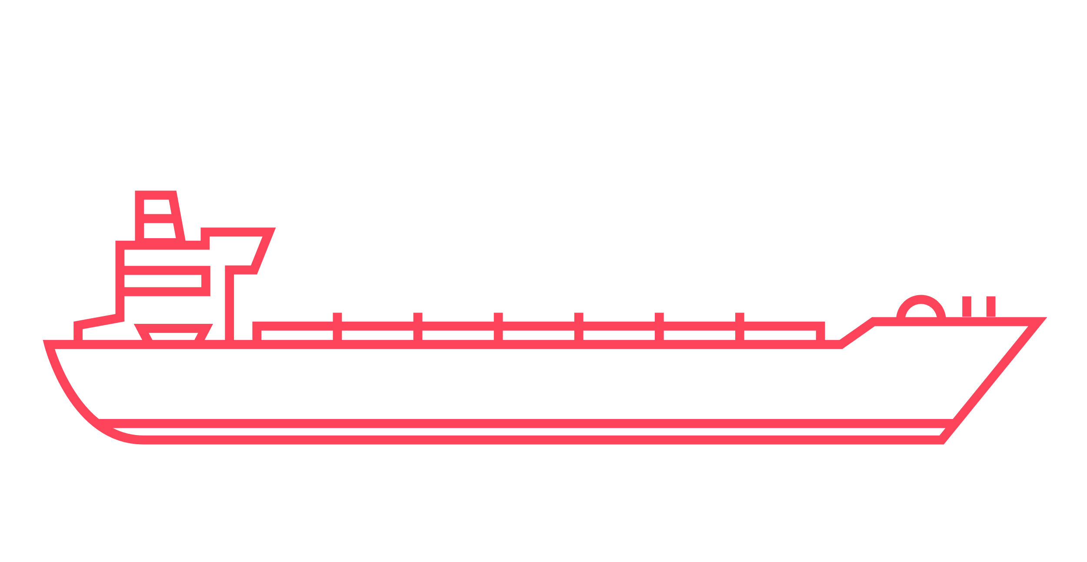
What I am not focusing on
Scope of Presentation
Electricity vs. Hydrogen → End use and costs are the key criteria
Import vs. Export of Hydrogen → Market prices and availability are determining
What I am focusing on
What is the optimal basket for my egg?
→ Possible hydrogen transport options and key decision criteria
Technologies: Ammonia (NH3), Liquid Hydrogen (LH2), Liquid Organic Hydrogen Carriers (LOHC), Pipelines to a certain extent

Slide 4
There are three relevant criteria for evaluating hydrogen transport options
Main topics
Cost Efficiency
Carrier Density
H₂-Purity
Use of existing infrastructure
Demand and supply of hydrogen or hydrogen derivative
GHG-Emissions
Availability
Use of existing infrastructure, i.e., port terminals, storage, ships & pipelines
Technology readiness level (TRL)
Safety
Regulatory Framework
Public Acceptance

Slide 5
1. Cost Efficiency

Slide 6
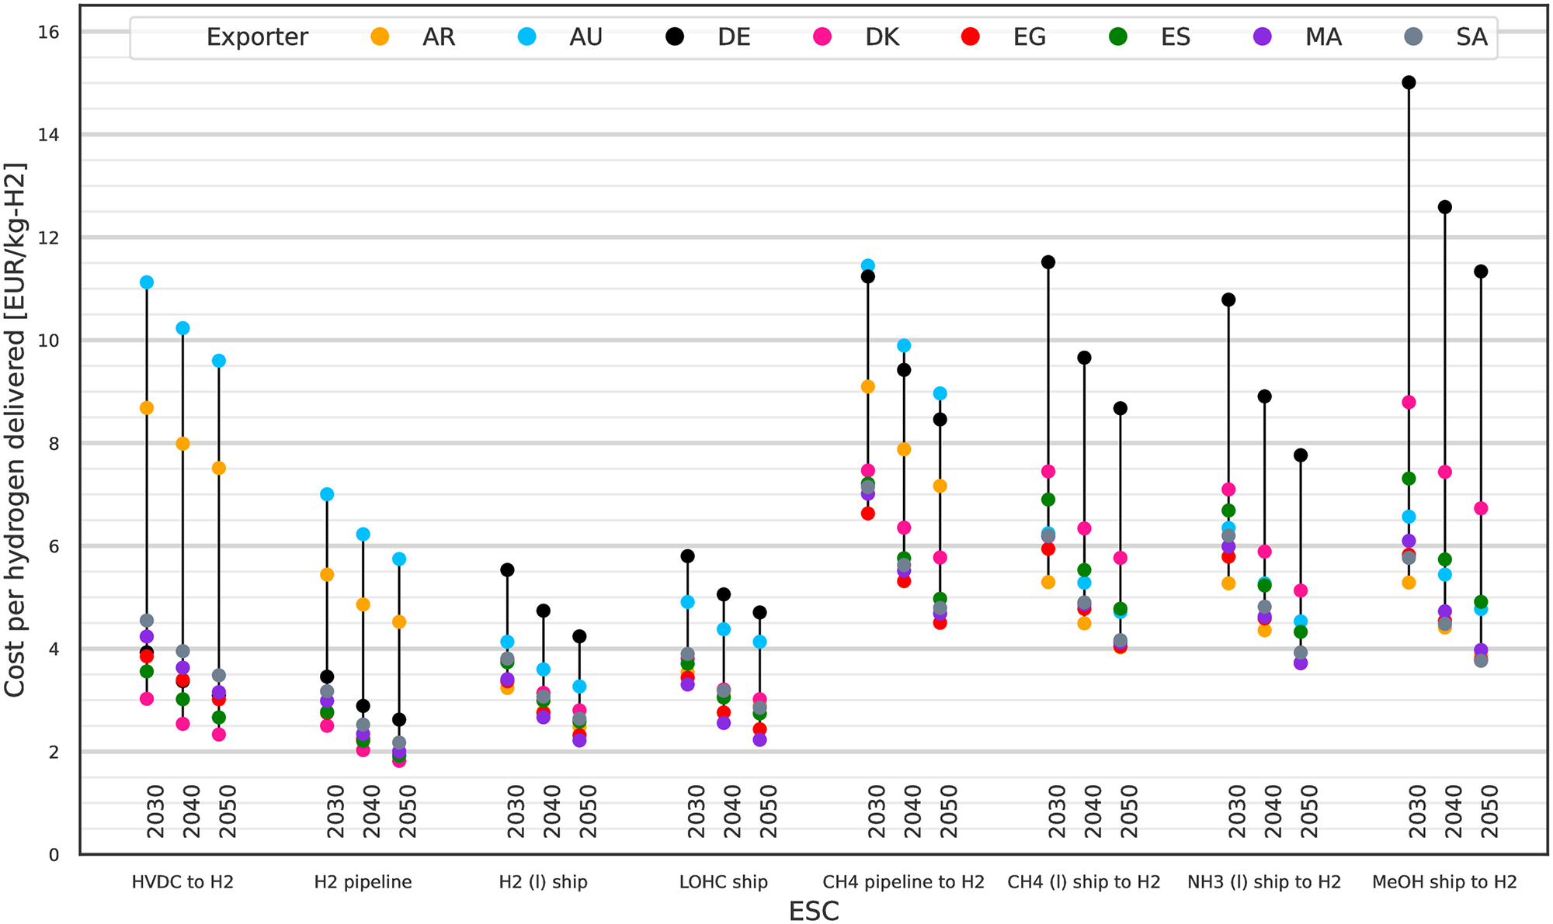
The cost efficiency is heavily depending on the assumptions of the model
Cost Efficiency
Levelised Cost of Hydrogen (LCoH) for Energy Supply Chains to Germany
Important cost-drivers:
H₂-Purity (98 vs. 99.5 %)
Existing infrastructure
Hydrogen or hydrogen derivative
Energy cost for (Re-) Conversions
Utilization of Pipeline/Infrastructure
Safety & regulatory measures
Authors conclusion: “no single exporter or Energy Supply Chain shows a unique techno-economic advantage over the others”
Source: Hampp et al. (2023); https://doi.org/10.1371/journal.pone.0281380

Slide 7
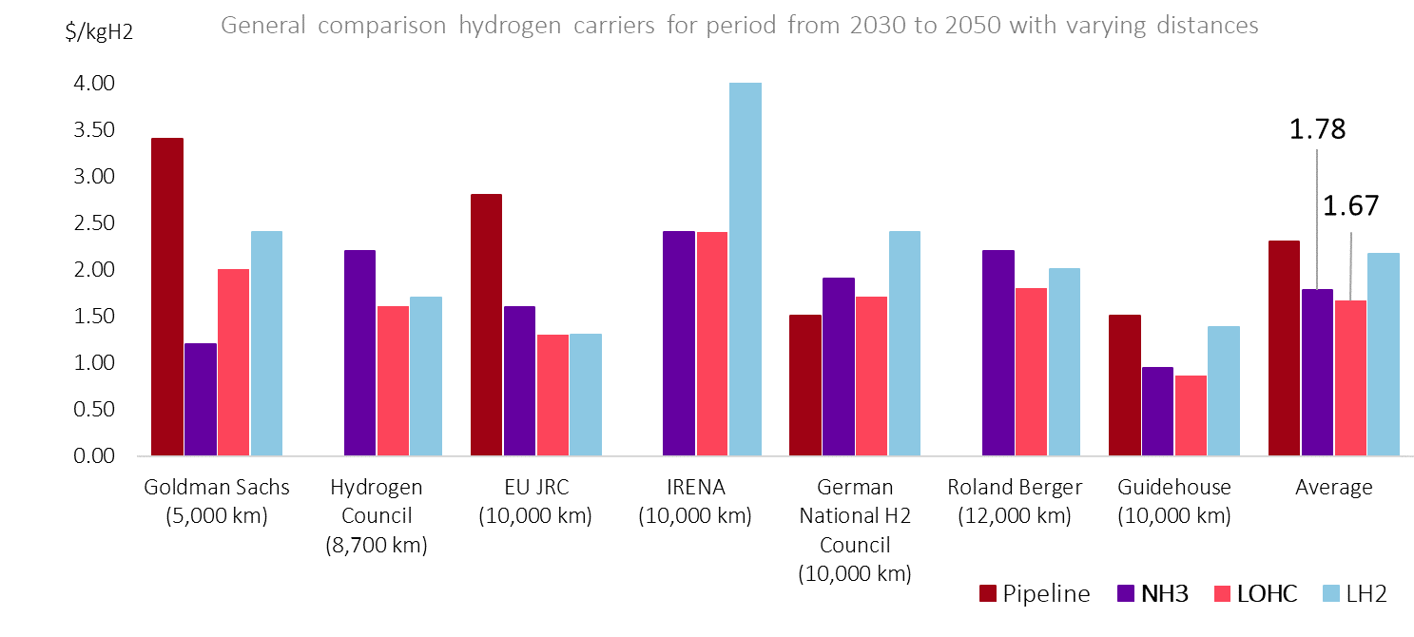
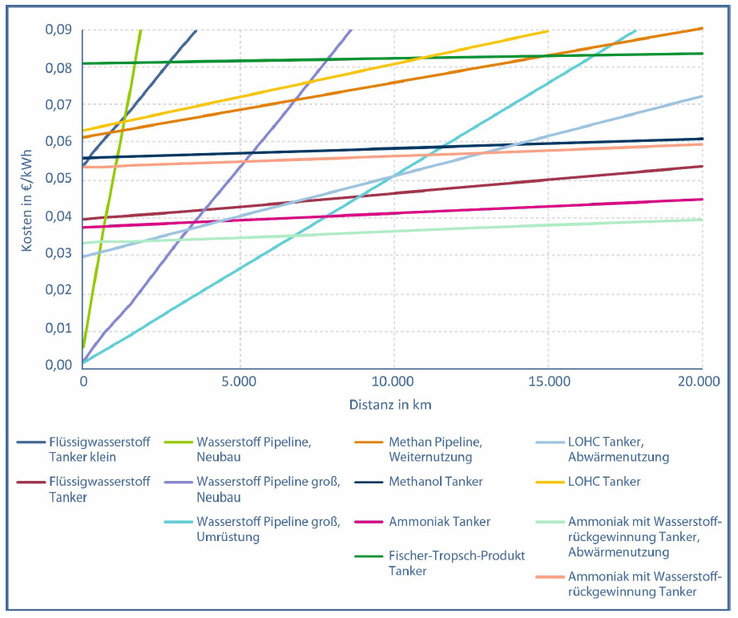
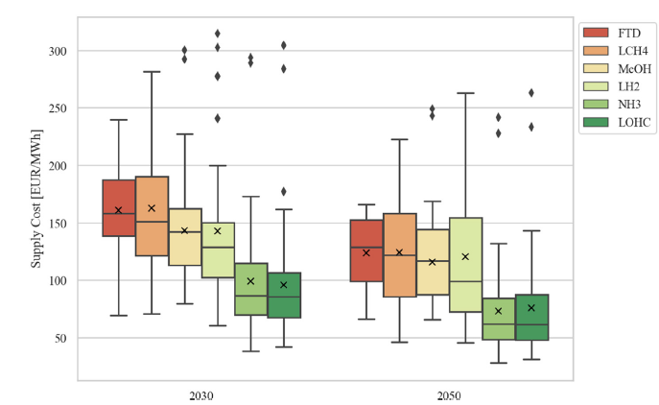
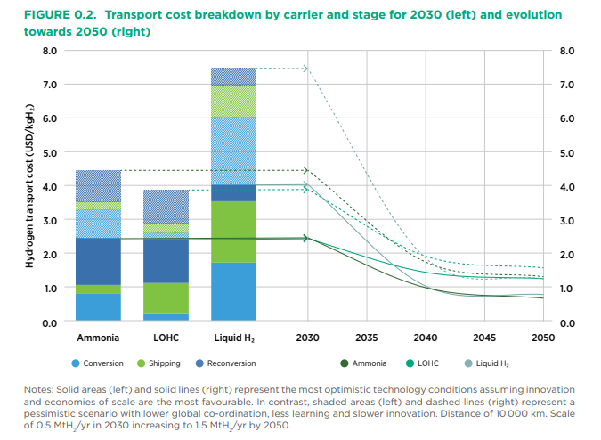
Cost Efficiency
Best practice:
Meta-Analysis with several studies and assumptions
Worthy of discussion:
Modeling based on few sources and unrealistic assumptions
Hydrogenious TCO Comparison (2023)
Optionen für den Import grünen Wasserstoffs nach Deutschland bis zum Jahr 2030, ESYS
Staiß, F. et al. (2022)
NH3-Cracker CAPEX based on deuterium cracker
Large differences in H₂-throughput between options
Supply costs of green chemical energy carriers at the European border: A meta-analysis,
Genge et. al. (2023)
Technology Review of H₂ Carriers; IRENA (2022)
Assumptions for carriers vary heavily
Cost parity of the main hydrogen carriers throughout the study landscape.
→ It really comes down to qualitative factors, which are usually not included in many analysis!

Slide 8
2. Availability

Slide 9
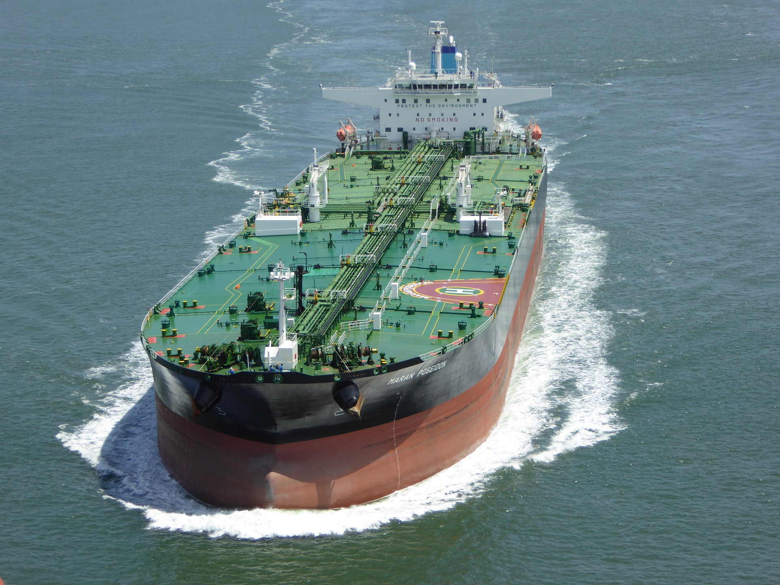
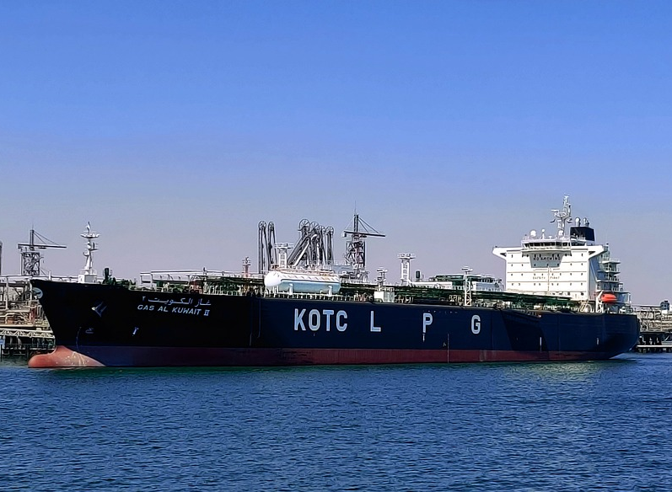
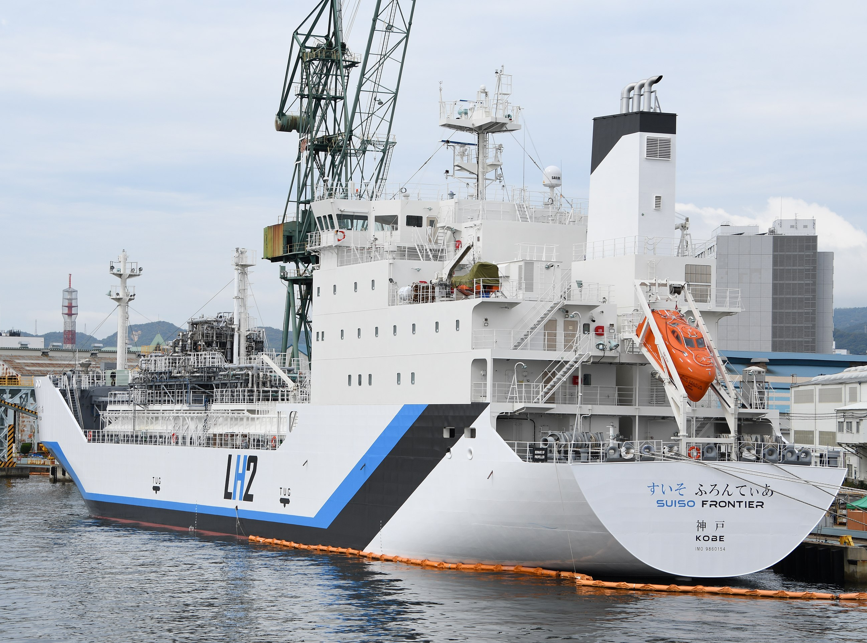
The availability of the transport option can be a huge bottleneck
Availability
Storage density
Potential vessel transport & hydrogen transport volumes
Existing global fleet
54 kg_{H2}/m³_{LOHC-BT}
62 kg_{H2}/t_{LOHC-BT}
Storage at ambient conditions
Potential transport in Very Large Crude Carriers
VLCC (280,000 DWT) can carry 17,000 tonnes of hydrogen
Upgrade to 450,000 DWT* possible
LOHC-BT
~ 800 vessels
115 kg_{H2}/m³_{NH3}
170 kg_{H2}/t_{NH3}
Storage at -33 °C at cryogenic conditions
Transport in LPG vessels
80k m³ LPG vessel can carry 9,800 tonnes of hydrogen
If LNG-ships can be repurposed +200
Ammonia (incl. Cracking)
~ 50 vessels
71 kg_{H2}/m³_{NH3}
Storage at -253 °C at cryogenic conditions
Transport in LH₂ vessels
The only existing LH₂ vessel ‘Suiso Frontier’ from Kawasaki can potentially carry 9,000 tonnes of hydrogen
But currently carries only 75 tons
Liquified H₂
= 100 vessels
1 vessel
*DWT = Deadweight tonnage
IEA: Meeting the potential tripling of NH₃ trade, building enough NH₃ tankers could create bottlenecks in the short term.
Source: IEA, Global Hydrogen Review 2023, Page 123

Slide 10
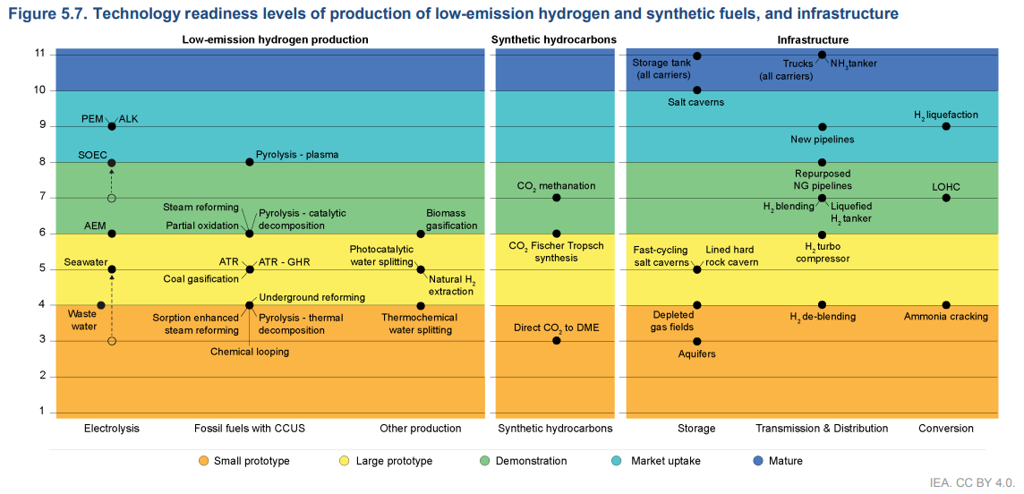
TRL - all technologies still have to mature and be scaled up to ensure availability
Availability
Basically, all large-scale projects that are considered and calculated already, are not feasible yet!
Source: IEA, Global Hydrogen Review 2023, Page 123

Slide 11
3. Safety

Slide 12
How can we enable a safe hydrogen supply chain?
Safety
Or: How to keep the egg from breaking?
LOHC-BT
Ammonia (incl. Cracking)
Liquified H₂
Hazard & toxicity profile
= Physical hazard
= Acute toxicity
= Envr. toxicity
= Low hazard/toxicity lvl.
= Medium hazard/toxicity lvl.
= High hazard/toxicity lvl.

Slide 13
Always look at all these criteria to evaluate H₂ transport options
Summary
Cost Efficiency
Carrier Density
H₂-Purity (98 va. 99.5 vs. 99.9997 %)
Use of existing infrastructure
Demand and supply of hydrogen or hydrogen derivative
GHG-Emissions (H2 leakage, N2O, CO2, …)
Availability
Use of existing infrastructure, i.e., port terminals, storage, ships & pipelines
Technology readiness level (TRL)
Safety
Regulatory Framework
Public Acceptance

Slide 14
Let’s carry the new energy world together.
HYDROGENIOUS LOHC TECHNOLOGIES GmbH Weidenweg 13 91058 Erlangen/Germany www.hydrogenious.net info@hydrogenious.net
Markus Albuscheit Strategic Analytics and Modeling

Slide 15
How to locally store the transported hydrogen? Especially, if natural gas storage not sufficient/not usable for hydrogen
Availlability
Or: How to store the eggs?
Storage
LOHC-BT
Use of widely existing infrastructure for
liquid oil infrastructure
Ammonia (incl. Cracking)
NH₃ infrastructure available in selected ports & areas
Liquified H₂
New infrastructure to be build up from scratch
→ „Rocket Science“

Slide 16
Qualitative Comparison of Hydrogen Transport Options
 | Ammonia incl. H2-Release/Cracking (NH₃) | Liquid Hydrogen (LH₂) | Liquid Organic Hydrogen Carriers (LOHC) | Pipeline Transport
Technological Readiness | ̶ | o | ̶ | o
Flexibility | o | + | o | ̶
Safety | o | o | ++ | ++
Scalibility | + | ̶ | + | +
Implementability | + | o | + | +

